Slide 1
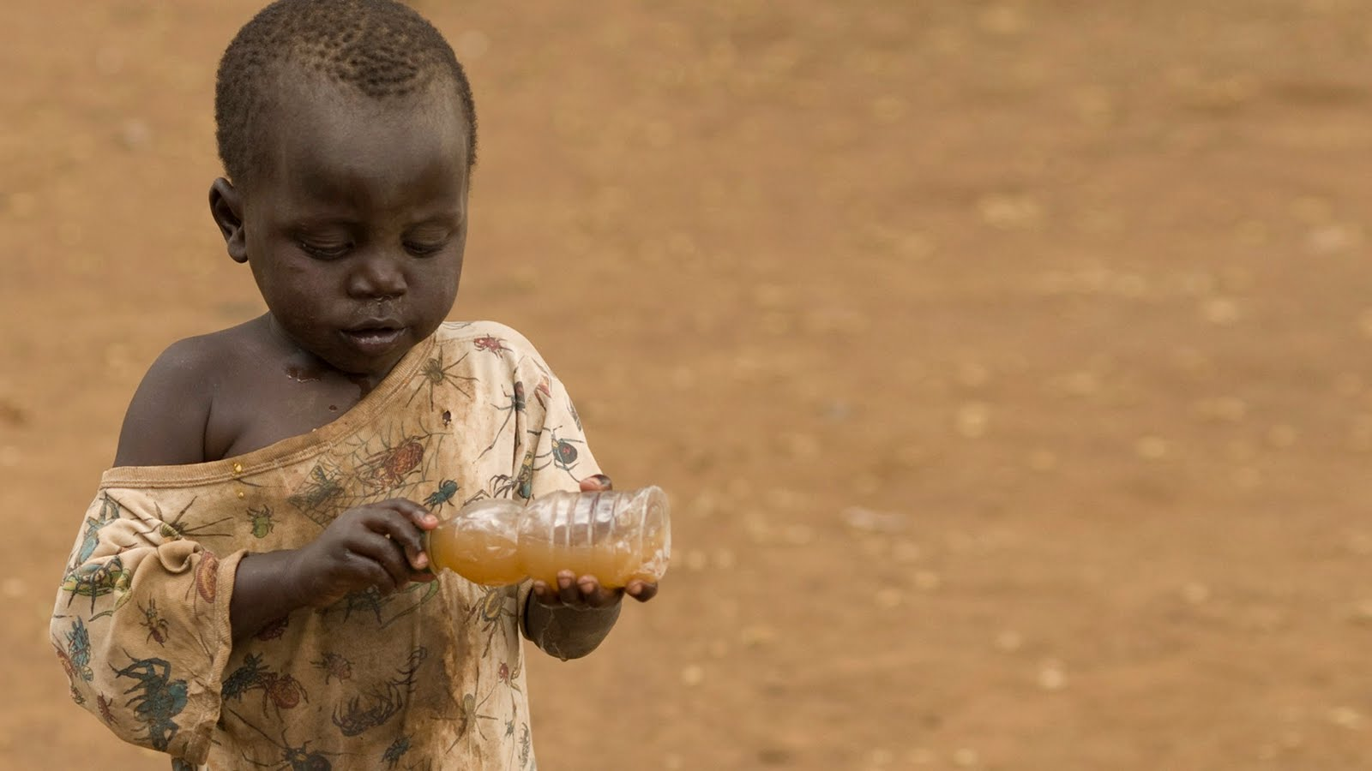
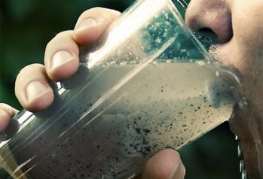
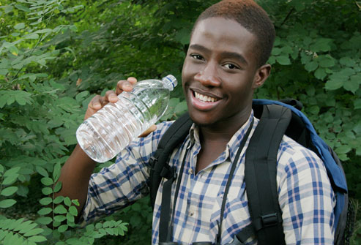
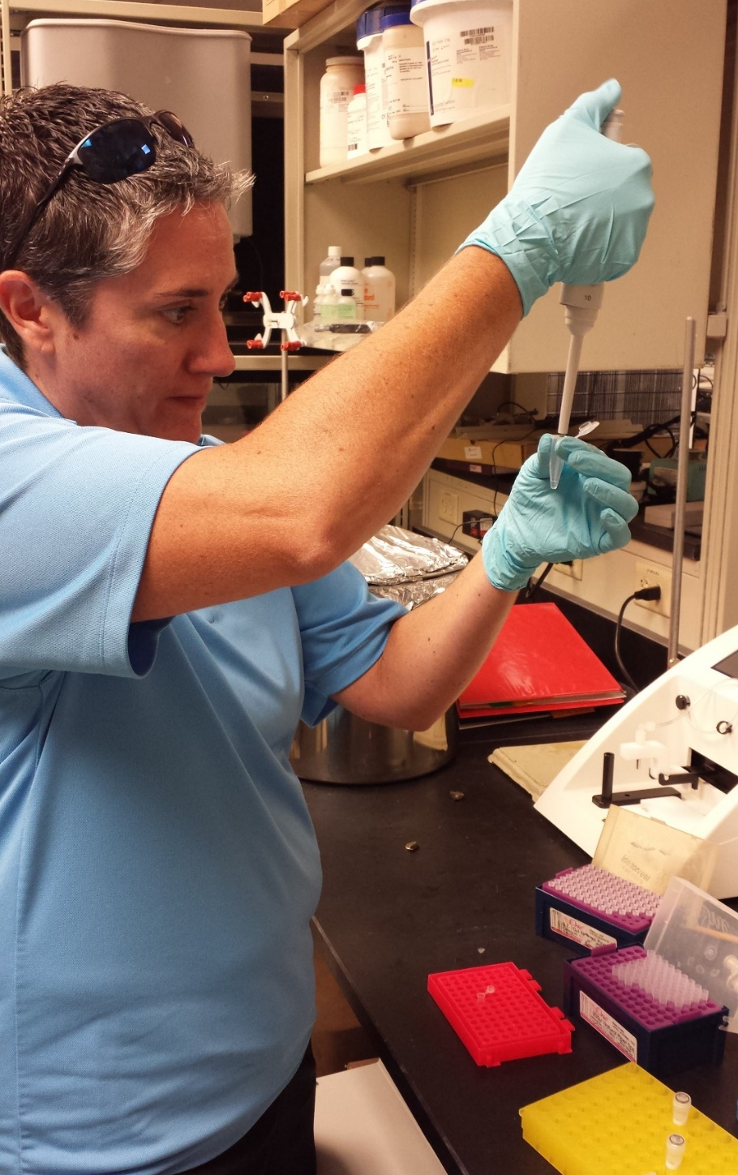
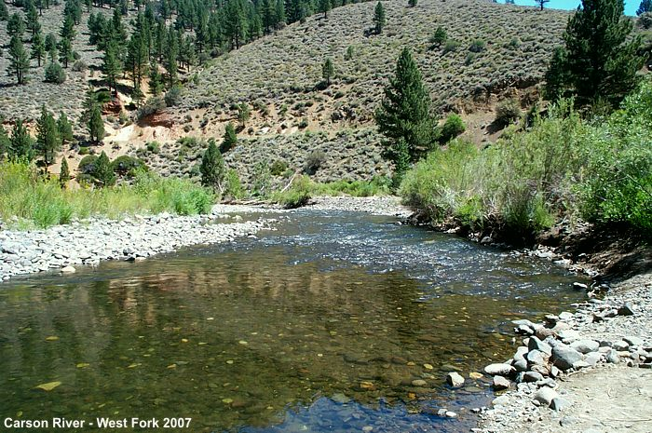
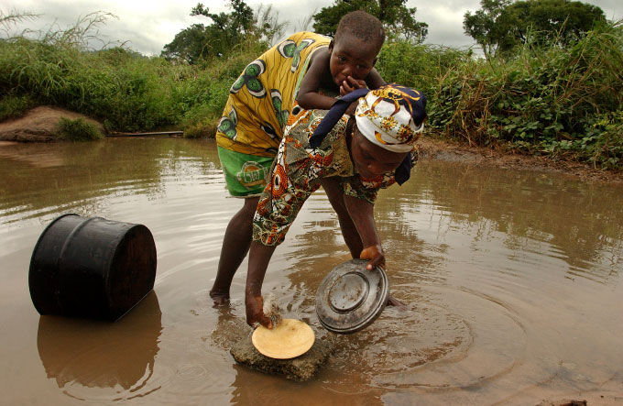
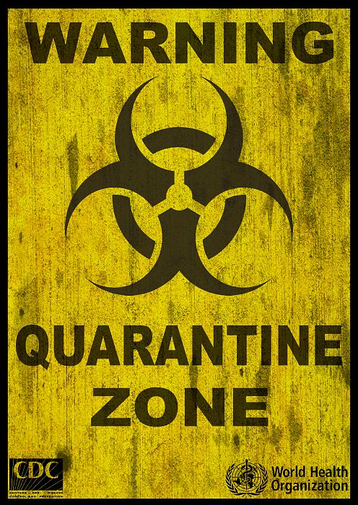
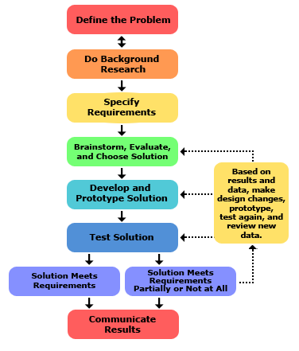
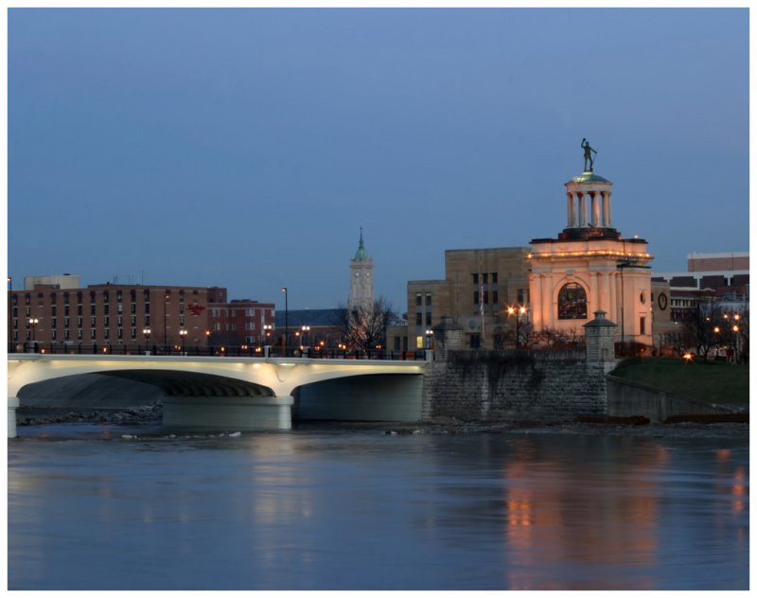
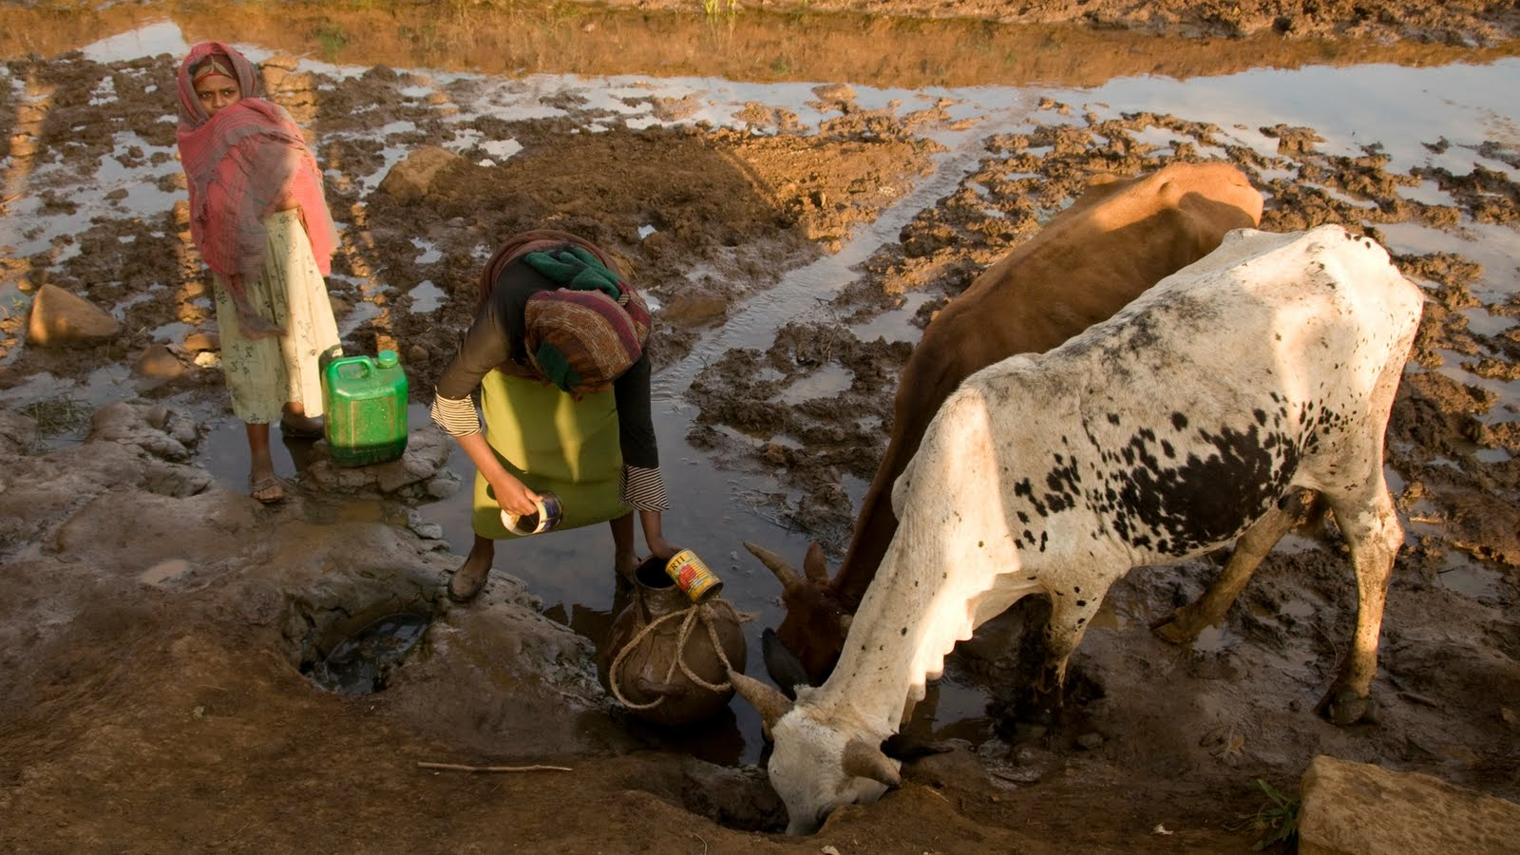
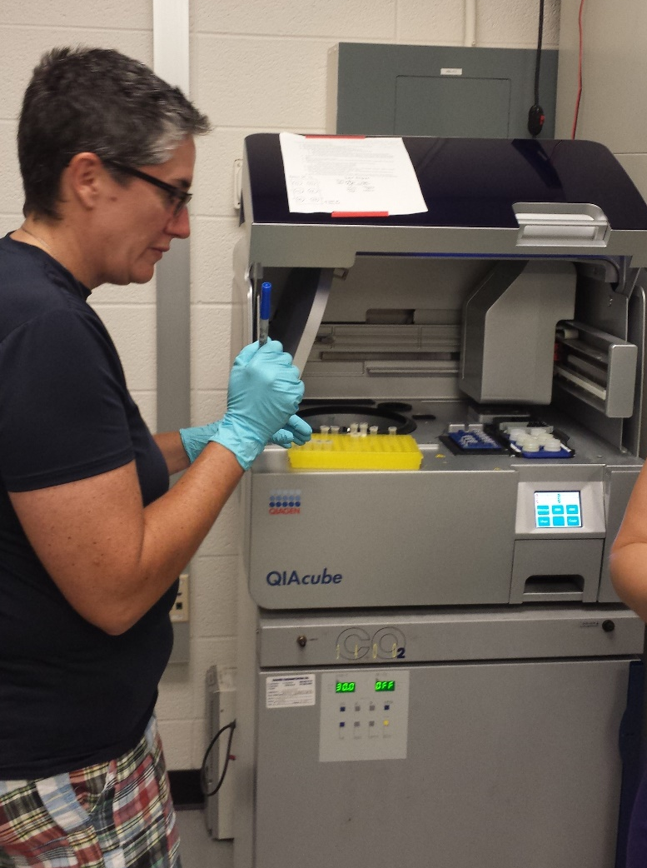
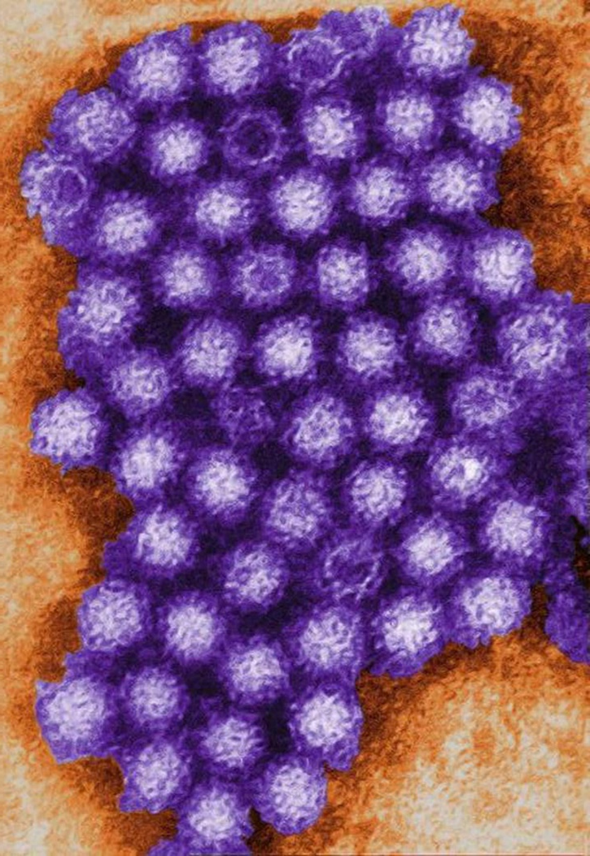
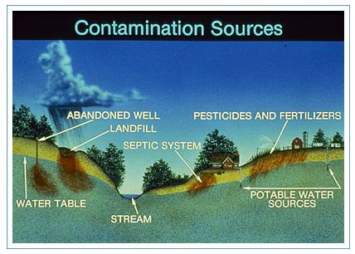
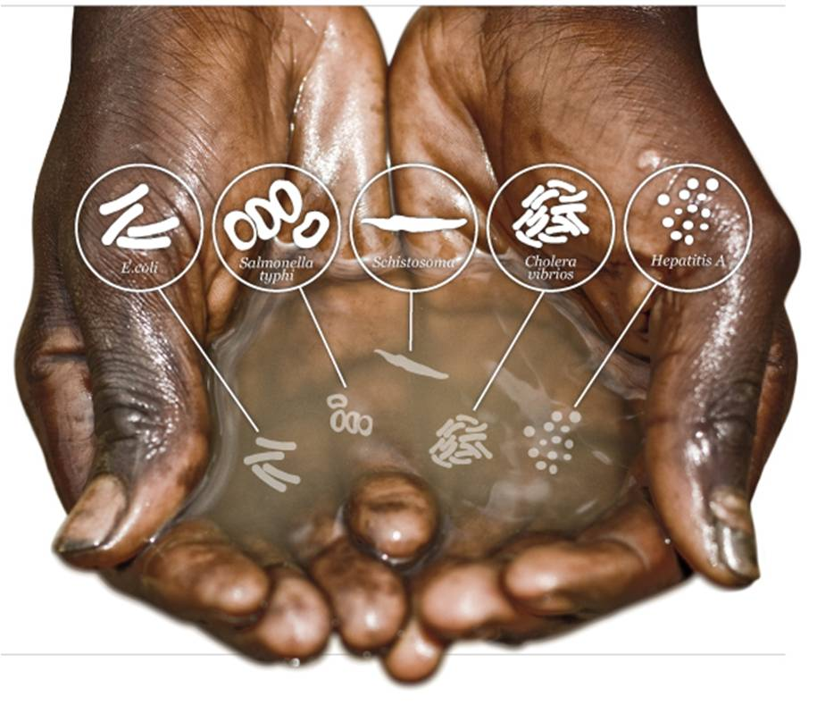
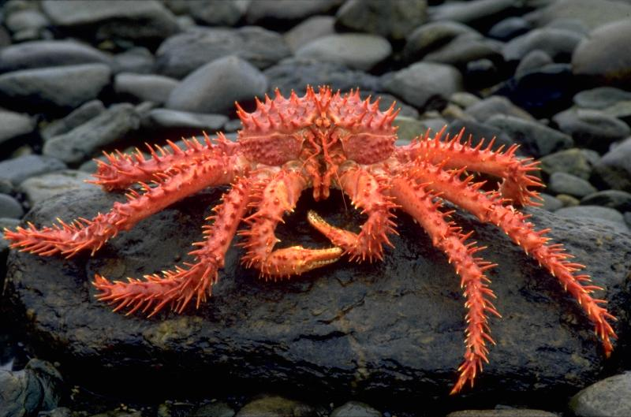
Water, Water Everywhere… Elizabeth Carlson Hamilton High School, Biology
RET is funded by the National Science Foundation, grant # EEC-1404766
Summer Research
Challenge Based Learning
The Big Idea
Creating a One-Step RNA
Virus Detection System
What is challenge based learning?
What are you drinking???
The norovirus is the leading cause of gastroenteritis in the U.S. Each year:
19-21 million illnesses
56,000-71,000 hospitalizations
570-800 deaths
“Challenge Based Learning is collaborative and hands-on, asking students to work with other students, their teachers, and experts in their communities and around the world to develop deeper knowledge of the subjects students are studying, accept and solve challenges, take action, share their experience, and enter into a global discussion about important issues.”
www.challengebasedlearning.org
Consuming contaminated food or drinking water can make you sick!
Where did it come from?
We need QUICK detection!
Quick treatment
Quick cleanup
Quick quarantine
Engineering Design Process
Current detection methods:
are slow
$$$$$$
Need fancy equipment
New detection method:
Uses Kamchatka crab enzyme
Duplex-specific Nuclease (DSN)
What’s in the water?
Research = mutate amino acids in DSN to improve detection system.

